Slide 1
Unit V
Activity and Multimedia with Databases

Slide 2
Activity
Activity is a screen that user interact with.
Every Activity in android has lifecycle like created, started, resumed, paused, stopped or destroyed.

Slide 3
Activity Life Cycle State
Create : activity is first created.
Start : activity is becoming visible to the user.
Resume : activity will start interacting with the user.
Pause :activity is not visible to the user.
Stop : activity is no longer visible to the user.
Restart : activity is stopped, prior to start.
Destroy :activity is destroyed.

Slide 4
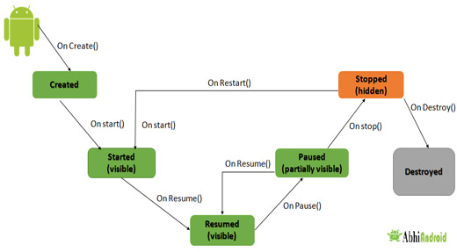

Slide 5
Activity Created: onCreate()
onCreate() method is called when activity gets memory in the OS.
Called when the activity is first created eg : user taps launcher icon.
Only called once during an activity’s lifecycle.
when an Activity gets forcefully terminated by any Operating System then savedInstanceState i.e. object of Bundle Class will save the state of an Activity.
It is best place to put initialization code.
onCreate() is always followed by onStart()

Slide 6
Activity Started: onStart():
Called when the activity is becoming visible to user.
Can be called more than once during lifecycle.
Followed by onResume()

Slide 7
Activity Resumed:.onResume():
Activity resumed is that situation when it is actually visible to user means the data displayed in the activity is visible to user.
In this state activity start interacting with user that means user can see the functionality and designing part of an application on the single screen.
The app will stays in this Resumed state until an another activity happens to take focus away from the app like getting a phone call or screen turned off, etc.
It always gets called after activity start and when activity paused.

Slide 8
Activity Paused: onPause():
In case if any interruption events happen in Resumed state, the activity will entered into Paused state and the system will invoke onPause() method.
After completion of onPause() method execution, the next method is either onStop() or onResume()
For example, if a user was using Application A and then a notification comes and user clicked on notification and moved to Application B, in this case Application A will be paused. And again if a user again click on app icon of Application A then Application A which was paused will again gets started.

Slide 9
onStop():The system will invoke onStop() callback method when an activity no longer visible to the user.
Application main thread is not always the UI thread. For example, when Activity is stopped, the onStop() is invoked, hence the UI thread is taken away from that Activity and moved to another Activity within the same or a different application. However it doesn't mean the application is no longer active, it can continue working in the background until it is closed either by OS or by user.
onRestart()
The system will invoke onRestart() method when an activity restarting itself after stopping it. The onRestart() method will restore the state of activity from the time that is being stopped.
onDestroy()
The system will invoke this onDestory() callback method either the activity is finishing or system destroying the activity to save space.

Slide 10
Logcat
Dumps a log of system messages, including stack traces when the device throws an error and messages that you have written from your app.
e() method is used to log errors.
w() method is used to log warnings.
i() method is used to log informational messages.
d() method is used to log debug messages.

Slide 11
displaying the content on the logcat.
protected void onCreate(Bundle savedInstanceState) { super.onCreate(savedInstanceState); setContentView(R.layout.activity_main); Log.d("lifecycle", " on create");
} @Override protected void onStart() { super.onStart(); Log.d("Activity Lifecycle","onStart invoked"); } @Override protected void onResume() { super.onResume(); Log.d("Activity Lifecycle","onResume invoked"); } @Override protected void onPause() { super.onPause(); Log.d("Activity Lifecycle","onPause invoked"); }

Slide 12
@Override protected void onStop() { super.onStop(); Log.d("Activity Lifecycle","onStop invoked"); } @Override protected void onRestart() { super.onRestart(); Log.d("Activity Lifecycle","onRestart invoked"); } @Override protected void onDestroy() { super.onDestroy(); Log.d("Activity Lifecycle","onDestroy invoked"); }

Slide 13
Intent (described as the intention to do action.)
Intent used for passing the information among Activities in an Application and from one app to another .
Intent is to perform an action. It is mostly used to start activity, send broadcast receiver, start services and send message between two activities.
There are two intents available in android as Implicit Intents and Explicit Intents.
Explicit Intent − It going to connect the internal world of an application such as start activity or send data between two activities.
Implicit Intents − It going to connect with out side application such as call, mail, phone, see any website ..etc.
Android intents are mainly used to:
Start the service
Launch an activity
Display a web page
Display a list of contacts
Dial a phone call etc.

Slide 14
Implicit Intent
doesn't specify the component. In such case, intent provides information of available components provided by the system that is to be invoked.
Eg :
Intent intent1=new Intent(Intent.ACTION_VIEW);
intent1.setData(Uri.parse("http://www.google.com"));
startActivity(intent1);

Slide 15
Different Methods Used in Intent
ACTION_PICK
Syntax:
It is using for picking the image from CAMERA or GALLERY.
Eg : Intent photoPickerIntent = new Intent(Intent.ACTION_PICK);
ACTION_CHOOSER
Use: It is used for choosing the image from the gallery.
ACTION_DIAL
Use – Display the phone dialer with the given number filled in.
ACTION_SEND
Use: Sending Text content from one activity to other.
ACTION_VIEW
Use : to open window

Slide 16
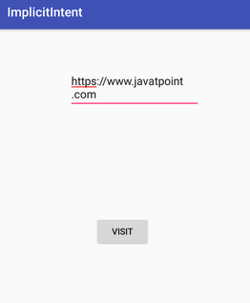
Implicit intent example
<Linearlayout
android:orientation=“vertical”>
<EditText
android:id="@+id/editText"
android:layout_width="wrap_content"
android:layout_height="wrap_content“ / >
<Button
android:id="@+id/button"
android:layout_width="wrap_content"
android:layout_height="wrap_content"
android:text="Visit" / >
</Linarlayout>

Slide 17
Implicit intent example . Java code
Button button;
EditText editText;
button = findViewById(R.id.button);
editText = findViewById(R.id.editText);
button.setOnClickListener(new View.OnClickListener() {
@Override
public void onClick(View view) {
String url=editText.getText().toString();
intent intent=new Intent(Intent.ACTION_VIEW, Uri.parse(url));
startActivity(intent);
//parse() method receives some string as input, "extracts" the necessary information from it
//Uri: a sequence of characters that allows the complete identification of any abstract or physical resource (Uniform resource identifier)
//Uniform Resource Identifier (URI) is a string of characters used to identify a resource. A URI identifies a resource either by location, or a name, or both.

Slide 18
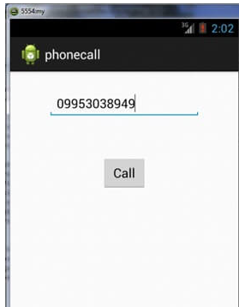
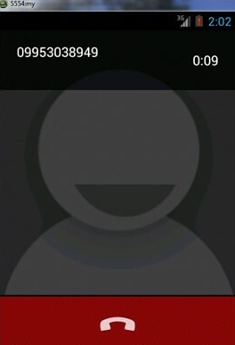
Implicit example – Phone call
<Button
android:id="@+id/button1"
android:layout_width="wrap_content"
android:layout_height="wrap_content"
android:text="Call" />
<EditText
android:id="@+id/editText1"
android:layout_width="wrap_content"
android:layout_height="wrap_content"
android:ems="10" />

Slide 19
EditText edittext1;
Button button1;
//Getting the edittext and button instance
edittext1=(EditText)findViewById(R.id.editText1);
button1=(Button)findViewById(R.id.button1);
//Performing action on button click
button1.setOnClickListener(new OnClickListener(){
@Override
public void onClick(View v) {
String number=edittext1.getText().toString();
Intent callIntent = new Intent(Intent.ACTION_CALL);
callIntent.setData(Uri.parse("tel:"+number));
startActivity(callIntent);
Note : tel are called Data schemes in android it tells the intent what application are you looking for
eg- if you use tel: it will tell the android system that you are looking for callling applicaion and it will open all the calling applications

Slide 20
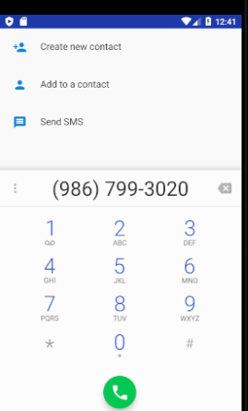
Implicit Intent example : Open Phone Dialer
<Button android:id="@+id/button1" android:layout_width="wrap_content" android:layout_height="wrap_content" android:layout_alignParentTop="true" android:layout_centerHorizontal="true" android:layout_marginTop="118dp" android:text="Call" /> <EditText android:id="@+id/editText1" android:layout_width="wrap_content" android:layout_height="wrap_content" android:layout_alignParentTop="true" android:layout_centerHorizontal="true" android:layout_marginTop="25dp" android:ems="10" />

Slide 21
EditText edittext1; Button button1; @Override protected void onCreate(Bundle savedInstanceState) { super.onCreate(savedInstanceState); setContentView(R.layout.activity_phonecall_example); //Getting the edittext and button instance edittext1=(EditText)findViewById(R.id.editText1); button1=(Button)findViewById(R.id.button1); //Performing action on button click button1.setOnClickListener(new View.OnClickListener() { @Override public void onClick(View v) { String number=edittext1.getText().toString(); Intent call_Intent = new Intent(Intent.ACTION_DIAL); call_Intent.setData(Uri.parse("tel:"+number)); startActivity(call_Intent);
tel are called Data schemes in android it tells the intent what application are you looking for
geo: it will tell androdid system that you are looking for a map or location app eg the google maps

Slide 22
Getting a Result from an Activity startActivityForResult() method
Starting another activity doesn't have to be one-way. You can also start another activity and receive a result back. To receive a result, call startActivityForResult() (instead of startActivity()).
For example, your app can start a camera app and receive the captured photo as a result.
By the help of android startActivityForResult() method, we can send information from one activity to another and vice-versa.
Syntax :
startActivityForResult(intent , request _code)
Intent : specify the action type
Request _code : specify your request

Slide 23
onActivityResult
onActivityResult method that is invoked automatically when second activity returns result.
When the user is done with the subsequent activity and returns, the system calls your activity's onActivityResult() method. This method includes three arguments:
void onActivityResult() (int requestCode, int resultCode, Intent data)
The request code you passed to startActivityForResult().
A result code specified by the second activity. This is either RESULT_OK if the operation was successful or RESULT_CANCELED if the user backed out or the operation failed for some reason.
An Intent that carries the result data.

Slide 24
requestCode
The integer argument is a "request code" that identifies your request.
The requestCode helps you to identify from which Intent you came back. For example, imagine your Activity A (Main Activity) could call Activity B (Camera Request), Activity C (Audio Recording), Activity D (Select a Contact).
Whenever the subsequently called activities B, C or D finish and need to pass data back to A, now you need to identify in onActivityResult() from which Activity you are returning from and put your handling logic accordingly.
Eg :
public static int CAMERA_REQUEST = 1;
public static int CONTACT_VIEW = 2; public void onActivityResult(int requestCode, int resultCode, Intent data)
{ if (requestCode == CAMERA_REQUEST) {
// code to handle data from CAMERA_REQUEST }
else if (requestCode == CONTACT_VIEW) {
// code to handle data from CONTACT_VIEW

Slide 25
Intent methods to set data n get data
how strings are being added to Extras:
Intent i = new Intent();
i.putExtra("Name", edt_name.getText());
i.putExtra("Description", edt_desc.getText());
how to extract them :
String name = data.getStringExtra("Name");
String desc = data.getStringExtra("Description");

Slide 26
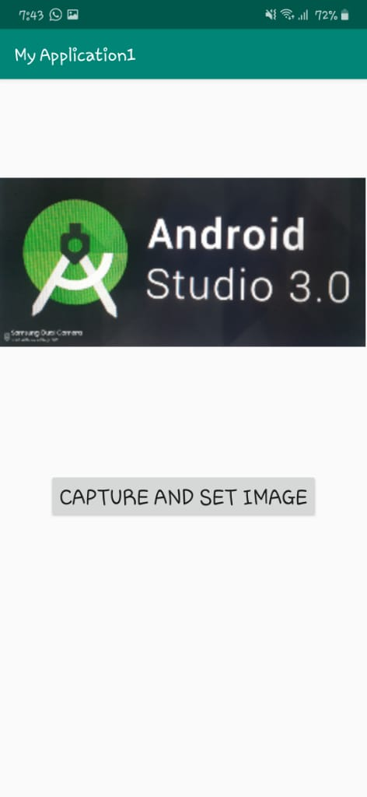
capture an image and display it using Image View
<ImageView android:id="@+id/im1" android:layout_width="410dp" android:layout_height="410dp" /> <Button android:id="@+id/b1" android:layout_width="wrap_content" android:layout_height="wrap_content" android:text="Capture and Set Image" android:textSize="25dp" android:layout_gravity="center" android:layout_marginTop="30dp" />

Slide 27
public class MainActivity extends AppCompatActivity { int CameraPhotoRequestCode=1; @Override protected void onCreate(Bundle savedInstanceState) { super.onCreate(savedInstanceState); setContentView(R.layout.activity_main); Button b1 = (Button) findViewById(R.id.b1); b1.setOnClickListener(new View.OnClickListener() { @Override public void onClick(View v) { Intent i1 = new Intent(MediaStore.ACTION_IMAGE_CAPTURE); startActivityForResult(i1,CameraPhotoRequestCode); } }); } protected void onActivityResult(int requestCode, int resultCode, Intent data) { ImageView im1 = (ImageView) findViewById(R.id.im1); super.onActivityResult(requestCode, resultCode, data); if (requestCode == CameraPhotoRequestCode){
//Android Camera application encodes the photo in the return Intent delivered to onActivityResult() as a small Bitmap in the extras, under the key "data". Bitmap photo = (Bitmap) data.getExtras().get("data"); im1.setImageBitmap(photo); } } }

Slide 28
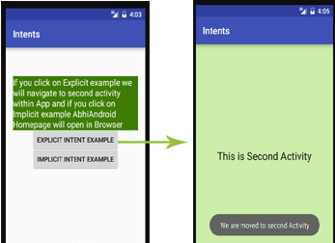
Explicit Intent:
Explicit Intents are used to connect the application internally.
Explicit Intent work internally within an application to perform navigation and data transfer.
For Example: we can navigate from One Activity to another activity using Intent.
In the similar way we can start a service to download a file in background process.
Eg : Intent intent1 = new Intent
(getApplicationContext(), SecondActivity.class);
startActivity(intent);

Slide 29
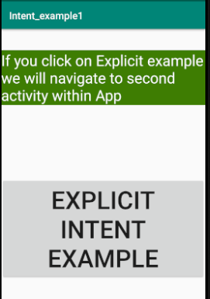
Explicit Intent example (MainActivity.xml)
<TextView
android:layout_width="wrap_content" android:layout_height="wrap_content“
android:text="If you click on Explicit example
we will navigate to second activity within App “
android:textSize="30sp"
android:id="@+id/textView2“ />
<Button
android:layout_width="wrap_content" android:layout_height="wrap_content
" android:text="Explicit Intent Example“
android:textSize="50sp"
android:id="@+id/explicit_Intent“ />

Slide 30
Explicit example .java code
Button explicit_btn;
explicit_btn = (Button)findViewById(R.id.explicit_Intent); explicit_btn.setOnClickListener(new View.OnClickListener() { @Override public void onClick(View v) { Intent intent1=new Intent (getApplicationContext(),second_activity.class);
startActivity(intent);

Slide 31
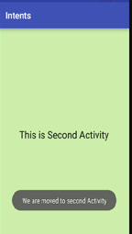
Explicit Intent example
(SecondActivity.xml)
<TextView android:layout_width="wrap_content" android:layout_height="wrap_content“
android:text="This is Second Activity“
android:id="@+id/textView
" android:layout_centerVertical="true" android:layout_centerHorizontal="true" />
(SecondActivity.java)
public class second_activity extends AppCompatActivity { @Override protected void onCreate(Bundle savedInstanceState) { super.onCreate(savedInstanceState); setContentView(R.layout.activity_second_activity); Toast.makeText(this,"We are moved to Second Activity", Toast.LENGTH_SHORT).show(); }

Slide 32
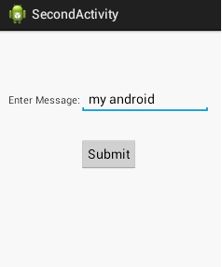
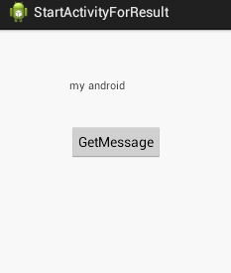
Example- Explicit Intent display msg of second activity to Main activity

Slide 33
MainActivity
button1.setOnClickListener(new OnClickListener() {
@Override
public void onClick(View arg0) {
Intent intent1=new Intent(MainActivity.this,SecondActivity.class);
startActivityForResult(intent1, 2); // Activity is started with requestCode 2
//The request code is any int value.
@Override
//invoked automatically when second activity returns result.
protected void onActivityResult(int requestCode, int resultCode, Intent data)
{ // The request code identifies from which acitivity the result is return
super.onActivityResult(requestCode, resultCode, data);
// check if the request code is same as what is passed here it is 2
if(requestCode==2)
{ if(resultCode == RESULT_OK){
String msg=data.getStringExtra("MESSAGE"); // get data included in the Intent
textView1.setText(msg);
//Toast.makeText(this,data.getData().toString(),Toast.LENGTH_SHORT).show();
}
}

Slide 34
SecondActivity
button1.setOnClickListener(new OnClickListener() {
@Override
public void onClick(View v) {
String msg=editText1.getText().toString();
Intent intent1=new Intent();
intent1.putExtra("MESSAGE", msg); // put data in the Intent
setResult(RESULT_OK,intent1); // setresult Method defined that returns the result code and intent data to main activity
//Result code is either RESULT_OK or RESULT_CANCELLED
finish(); //finishing activity
}

Slide 35
MainActivity : take number SecondAcitivity : display factorial
button1.setOnClickListener(new OnClickListener() {
@Override
public void onClick(View v1) {
num=Integer.ParseInt(e1.getText().toString());
For (i=1;i<=num;i++)
fact=fact * i ;
str = String.valueof(fact);
Intent intent1=new Intent(MainActivity.this , SecondAcitivity.class);
intent1.putExtra( “ factorial “ , str );
startActivity(intent1);
finish();
}

Slide 36
SeconActivity.class
public class secondActivity extends AppCompatActivity { @Override protected void onCreate(Bundle savedInstanceState) { super.onCreate(savedInstanceState); setContentView(R.layout.activity_main);
textView txt1 = (TextView) findViewById(R.id.t1);
Intent intent_fact=getIntent(); //pass data to second Activity
String str = intent_fact.getStringExtra(“factorial”);
txt1.settext(str);
}
}

Slide 37
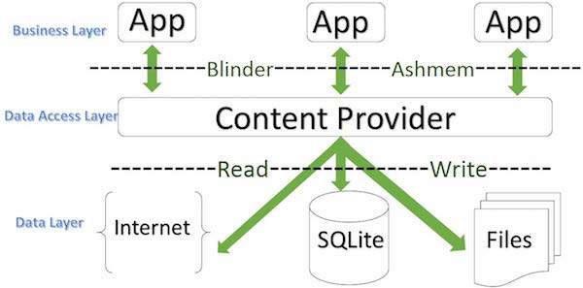
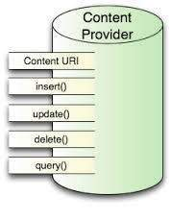
Content Provider
A content provider component supplies data from one application to others on request.
Content providers let you centralize content in one place and have many different applications access it as needed.
In most cases this data is stored in an SQlite database.
can perform a multiple operations like insert, update, delete and edit on the data stored

Slide 38
Content URI
Content URI(Uniform Resource Identifier) is the key concept of Content providers. To access the data from a content provider, URI is used as a query string.
Structure of a Content URI: content://authority/optionalPath/optionalID
1 content://
Mandatory part of the URI as it represents that the given URI is a Content URI
2 authority
This specifies the name of the content provider, for example contacts, browser etc. For third-party content providers, this could be the fully qualified name. This part must be unique for every content provider.
3 data_type
This indicates the type of data that this particular provider provides. For example, if you are getting all the contacts from the Contacts content provider, then the data path would be people and URI would look like this content://contacts/people
4 id
This specifies the specific record requested. It is a numeric value that is used when there is a need to access a particular record.
For example, if you are looking for contact number 5 in the Contacts content provider then URI would look like this content://contacts/people/5.

Slide 39
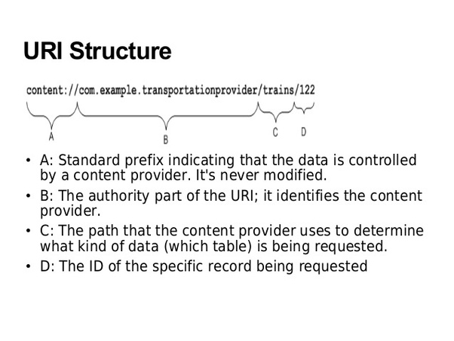

Slide 40
Create Content Provider
First of all you need to create a Content Provider class that extends the ContentProvider baseclass.
Second, you need to define your content provider URI address which will be used to access the content.
Next you will need to create your own database to keep the content. Usually, Android uses SQLite database
Next you will have to implement Content Provider queries to perform different database specific operations.
Finally Register content provider in AndroidManifest.xml file using <provider.../> tag

Slide 41
Methods of Content Provider
onCreate() This method is called when the provider is started.
query() This method receives a request from a client. The result is returned as a Cursor object.
insert()This method inserts a new record into the content provider.
delete() This method deletes an existing record from the content provider.
update() This method updates an existing record from the content provider.

Slide 42
Service
Android service is a component that is used to perform operations on the background such as playing music, handle network transactions, interacting content providers etc.
As services run in background. By background, it means that it doesn’t have a user interface. A Service runs on the main thread of the calling Component’s process by default
The service runs in the background indefinitely even if application is destroyed.
As the service has no user interface, it is not bound to the lifecycle of an activity.

Slide 43
why we have to use service
Eg : Music Application.We need songs to be played continuously even if we leave music app.If we use activities,we can't achieve above requirement.So,service helps in these kind of scenarios.Even if the app is not in foreground, service keeps on running and we are able to listen to songs.This is why we use service even though it runs on main thread.

Slide 44
A service can essentially take two states −
1. Unbind / Started
If a service can be started by the application component then it is called started service.
A service is started when an application component, such as an activity, starts it by calling startService().
Once started, a service can run in the background indefinitely, even if the component that started it is destroyed.
Started service performs a single operation and doesn’t return a result to the caller.
Eg : when download a file over the network , when upload completes the service stop itself by calling stopService().
2. Bound
A service is bound when an application component binds to it by calling bindService().
A bound service offers a client-server interface that allows components to interact with the service, send requests, get results.
Multiple components can bind to service at once , but when all of them unbind , the service is destroyed.

Slide 45
UnBound Service:
1.Basically used for long repetitive task.
2.startService() is the method use to start unbound service.
3.stopService() is the method use to stop explicitly.
4.It is independent of the component from which it starts.
Bound Service:
1.Basically used for long repetitive task but bound with the component.
2.starts by bindService().
3.unbindService() is the method use to stop explicitly.
4.It is dependent of the component from which it starts

Slide 46
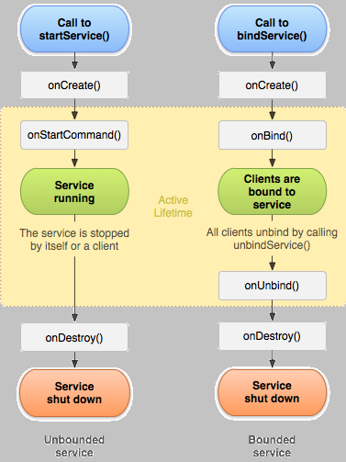

Slide 47
Android Service Callback Methods
onStartCommand()
The system will invoke this callback method when main activity requests the service to be started by calling startService(). When this method executed, the service will start and run indefinitely in background.
And stop the service once code execution is done by calling stopService().
The onStartCommand() method will return a value from one of the following constants.
START_STICKY: It will restart the service in case if it terminated.
START_NOT_STICKY:It will not restart the service and it is useful for the services which will run periodically.
It’s a best option to avoid running a service in case if it is not necessary.

Slide 48
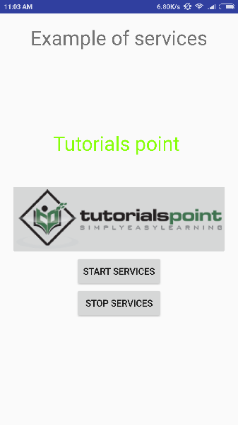
Service example
<Button android:id="@+id/btnStart" android:layout_width="wrap_content" android:layout_height="wrap_content" android:onClick="start“ android:text="Start Service"/>
<Button android:id="@+id/btnstop" android:layout_width="wrap_content" android:layout_height="wrap_content" android:onClick="stop" android:text="Stop Service"/>

Slide 49
MainActivity .XML file
public class service_exampe1 extends AppCompatActivity { @Override protected void onCreate(Bundle savedInstanceState) { super.onCreate(savedInstanceState); setContentView(R.layout.activity_service_exampe1); } //startService() is the method use to start unbound service. ie onStartCommand() public void start(View view) { Intent intent1 = new Intent(this,Myservice.class); startService(intent1); } //stopService() is the method use to destroy service. ie onDestroy() public void stop(View view) { Intent intent1 = new Intent(this, Myservice.class); stopService(intent1);

Slide 50
MyService.class
public class Myservice extends Service { private MediaPlayer player; @Override public void onCreate() { Toast.makeText(this, "Service was Created", Toast.LENGTH_LONG).show(); } @Override //The system will invoke this method when an another component such as an // Mainactivity requests the service to be started by calling startService(). public int onStartCommand(Intent intent1 , int flags, int startId){ player = MediaPlayer.create(this, Settings.System.DEFAULT_RINGTONE_URI); // It will start the player player.start(); Toast.makeText(this, "Service Started", Toast.LENGTH_LONG).show(); return START_STICKY; } @Override public void onDestroy() { player.stop(); // Stopping the player when service is destroyed Toast.makeText(this, "Service Stopped", Toast.LENGTH_LONG).show(); }

Slide 51
Broadcast Intent
Basically intent are of two types:
Implicit - Explicit
Broadcast Intent :
which don’t start activities but instead are delivered to broadcast receiver
1. system broadcast intent: delivered by the system.
Eg : For example, applications can register for various system events like boot complete or battery low, and Android system sends broadcast when specific event occur.
2.custom broadcast intent : those that your app delivers.
Eg : when you want let other app know that data has been downloaded to the device.

Slide 52
Difference between Activity intent and Broadcast Intent
The intent used to start activity makes changes to an operation and user is aware of the process.
In case of broadcast intent the operation runs completely in background and it is invisible to user.

Slide 53
System broadcast intent
For example, applications can register for various system events like boot complete or battery low, and Android system sends broadcast when specific event occur.
android.intent.action.BATTERY_LOW
Indicates low battery condition on the device.
android.intent.action.BATTERY_OKAY
Indicates the battery is now okay after being low.
android.intent.action.BOOT_COMPLETED
This is broadcast once, after the system has finished booting.

Slide 54
Broadcast Receiver
Broadcast Receivers A broadcast receiver (receiver) allows you to register for system or application events.
All registered receivers (App) for an event are notified by the Android runtime once this event happens.
If the event for which the broadcast receiver(App) has registered happens, the onReceive() method of BroadcastReceiver class is called by the Android system.
Two steps
Creating the Broadcast Receiver.
Registering Broadcast Receiver

Slide 55
Broadcast Receiver
Two steps
Creating Broadcast Receiver :
All registered receivers (App)for an event are notified by the Android runtime once the event happens.
If the event for which the broadcast receiver has registered happens, the onReceive() method of BroadcastReceiver() class is called by the Android system.
Registering Broadcast Receiver :
Application listens for a specific broadcast intents by registering a broadcast receiver in AndroidManifest.xml file.
Eg : register MyReceiver for the system generated event ACTION_BOOT_COMPLETED . This registered broadcast receiver is fired when android system has completed the boot process.

Slide 56
In android, Broadcast Receiver is implemented as a subclass of BroadcastReceiver and each broadcast is delivered as an Intent object.
Register an app to receive broadcast messages based on our requirements. When a broadcast received, the system will check for specified broadcasts have subscribed or not based on that it will routes the broadcasts to the apps.

Slide 57
Example : like …
If (a<b)……………event occur
Fact();……………registering broadcast receiver
Fact()………………..creating broadcast receiver
{
}

Slide 58
Steps of Broadcast intent
1.Create broadcast reciever named MyReciever : onReceive() method will be called when event occur
// MyReciever class which extends BroadcastReceiver public class MyReciever extends BroadcastReceiver { public void onReceive(Context context, Intent intent) { Toast.maketext(“ system boot complete”)
}

Slide 59
Steps of Broadcast intent
2. Register or define broadcast receiver Via the AndroidManifest.xml file.
Eg : <receiver android:name="MyReceiver">
// intent filters we tell the system any intent that matches our subelements should get delivered to that specific broadcast receiver.
<intent-filter>
<action android:name="android.example.action.BOOT_COMPLETED"> </action>
</intent-filter> </receiver> </application>
Now whenever your Android device gets booted, it will be intercepted by BroadcastReceiver MyReceiver and implemented logic inside onReceive() will be executed.

Slide 60
Custom Broadcast intent
Broadcast intent that your application send out by using the sendBroadcast()
Eg : when you want let other app know that data has been downloaded to the device.
TO create custom boradcast intent , create custom intent action. To deliver a custom broadcast to other app, pass the intent to SendBroadcast()

Slide 61
Custom Broadcast steps….
1.Create broadcast reciever MyReceiver :
Eg ://MyReciever class which extends BroadcastReceiver public class MyReceiver extends BroadcastReceiver { public void onReceive(Context context, Intent intent) { Toast.makeText(this , “Intent deteced “ ).show }
2.register or Define BroadcastReceiver in AndroidManifest.xml file .
Eg : <receiver android:name="MyReceiver" > <intent-filter> <action android:name="com.example1.CUSTOM_INTENT” /> </intent-filter> </receiver>
3. Send Broadcast event : Create new intent and broadcast it
eg : Intent intent1 = new Intent(); intent1.setAction(" com.example1 .CUSTOM_INTENT"); sendBroadcast(intent);

Slide 62
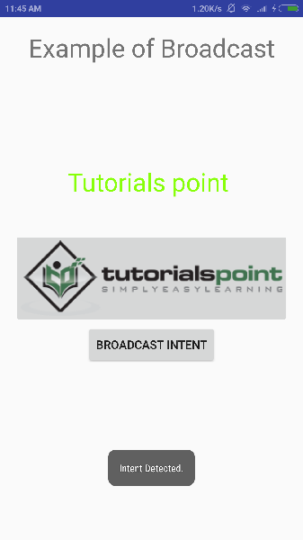
Custom Broadcast Example1
<TextView android:id="@+id/textView1"
android:layout_width="wrap_content"
android:layout_height="wrap_content"
android:text="Example of “ />
<TextView android:id="@+id/textView2“
android:layout_width="wrap_content“
android:layout_height="wrap_content"
android:text="Tutorials point “ />
<ImageButton
android:layout_width="wrap_content"
android:layout_height="wrap_content"
android:id="@+id/imageButton"
android:src="@drawable/abc“ />
<Button android:layout_width="wrap_content"
android:layout_height="wrap_content"
android:id="@+id/button2"
android:text="Broadcast Intent“
android:onClick="broadcastIntent“ />

Slide 63
Custom Broadcast .MainActivity.java
public class custom_boradcast_example1 extends AppCompatActivity { @Override protected void onCreate(Bundle savedInstanceState) { super.onCreate(savedInstanceState); setContentView(R.layout.activity_custom_boradcast_example1); } public void broadcastIntent(View view){ Intent intent1 = new Intent();
intent1.setAction("com.example1.CUSTOM_INTENT"); sendBroadcast(intent1); } }

Slide 64
1. Creating Broadcast Receiver my_reciever
Java Code of New File(my_receiver.class )_
public class my_receiver extends BroadcastReceiver { @Override // onReceive() method of the my_receiver is called when event occur public void onReceive(Context context , Intent intent1) { Toast.makeText(context, "Intent Detected", Toast.LENGTH_SHORT).show(); } }
2. Register Broadcast Receiver in Manifest file
<receiver android:name="my_receiver"> <intent-filter> <action android:name=“com.example1.CUSTOM_INTENT"></action> </intent-filter> </receiver>

Slide 65
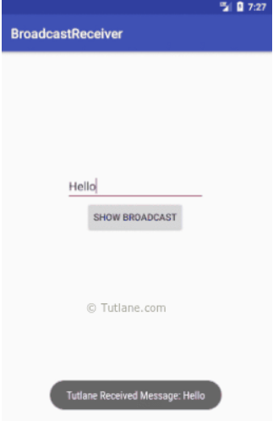
Custom Broadcast example 2
<Button
android:id="@+id/btnShow"
android:layout_width="wrap_content"
android:layout_height="wrap_content"
android:onClick="onClickShowBroadcast"
android:layout_marginLeft="130dp"
android:text="Show Broadcast”/>

Slide 66
MainActivity
public class MainActivity extends AppCompatActivity {
@Override
protected void onCreate(Bundle savedInstanceState) {
super.onCreate(savedInstanceState);
setContentView(R.layout.activity_main);
}
public void onClickShowBroadcast(View view){
EditText st = (EditText)findViewById(R.id.txtMsg);
Intent intent = new Intent();
intent.putExtra("msg",st.getText().toString());
intent.setAction("com.example.CUSTOM_INTENT");
sendBroadcast(intent);
}
}

Slide 67
MyBroadcastReceiver
public class MyBroadcastReceiver extends BroadcastReceiver {
@Override
public void onReceive(Context context, Intent intent){
string iData = intent.getExtra("msg");
Toast.makeText(context," Received Message: "+iData,Toast.LENGTH_LONG).show();
}
}

Slide 68
Manifest File
<receiver android:name="MyBroadcastReceiver">
<intent-filter>
<action android:name="com.example.CUSTOM_INTENT">
</action>
</intent-filter>
</receiver>

Slide 69
Fragment
Android Fragment is the part of activity, it is also known as sub-activity.
There can be more than one fragment in an activity. Fragments represent multiple screen inside one activity.
single activity but each activity can comprise of multiple fragments which will have their own layout, events and complete life cycle.
Android fragment lifecycle is affected by activity lifecycle because fragments are included in activity.
You can add or remove fragments in an activity while the activity is running.
A fragment can be used in multiple activities.
Fragment life cycle is closely related to the life cycle of its host activity which means when the activity is paused, all the fragments available in the activity will also be stopped.

Slide 70
Limitation of single activity
we can show only a single activity on the screen at one given point in time.
not able to divide device screen and control different parts separately.

Slide 71
Uses of Fragment
Flexible user interface across different screen size
Fixed / scrolling / swipe tab display eg : watsApp tabs→ 3 different fragment on single activity.
To display dialog boxes eg : Do u want to exit
Tab modes possible with fragment.

Slide 72
Types of Fragments
Single frame fragments − Single frame fragments are using for hand hold devices like mobiles, here we can show only one fragment as a view.
List fragments− This Fragment is used to display a list-view from which the user can select the desired sub-activity. ...
Fragments transaction − Fragment Transaction: This kind of fragments supports the transition from one fragment to another at run time. Users can switch between multiple fragments like switching tabs.

Slide 73
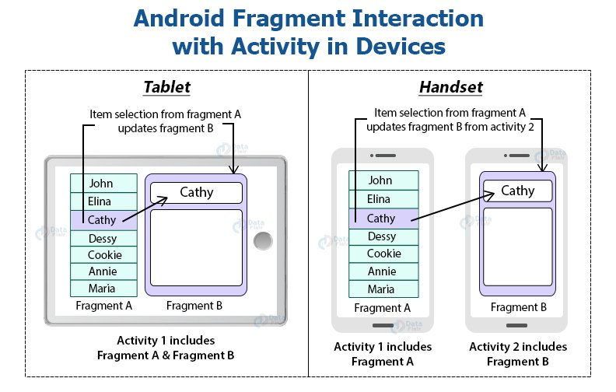

Slide 74
FFFFFFFVDCDC
FFFFFFFVDCDC
FRAGMENT A
FRAGMENT Z
FRAGMENT B
FRAGMENT C
FRAGMENT B
FRAGMENT C

Slide 75
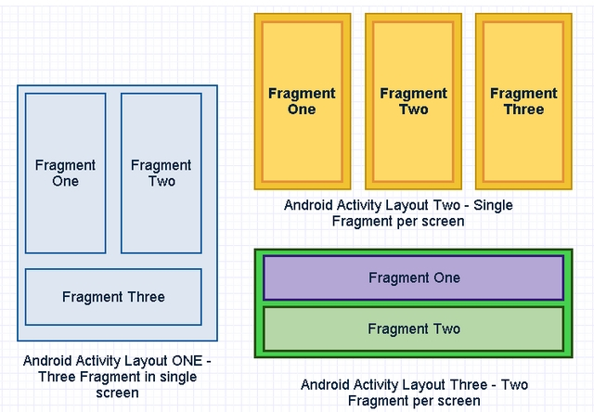

Slide 76
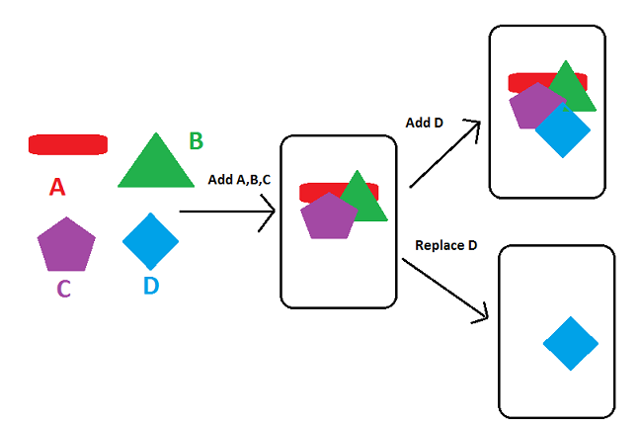

Slide 77
How to add fragment
Add a fragment using XML
Define fragment within mainAtcivity xml by calling fragment class name in android:name attribute.
If you add fragment using xml , then it is not possible to remove the fragment at run time.
Add fragment programmatically to remove or replace
Add a fragment using runtime
Create object of FragmentManager class and FragmentTransaction class

Slide 78
How to use Fragments
1.decide how many fragments you want to use in an activity.
2.based on number of fragments, create classes which will extend the Fragment class.
3.Corresponding to each fragment, you will need to create layout files in XML file. These files will have layout for the defined fragments.
4.Finally modify activity file to define the actual logic of replacing fragments

Slide 79
onCreateView() The system calls this callback when it's time for the fragment to draw its user interface for the first time. To draw a UI for your fragment, you must return a View component from this method
Syntax :
public View onCreateView (LayoutInflater inflater, ViewGroup container, Bundle savedInstanceState)
Inflater : This LayoutInflater object that can be used to inflate any views in the fragment.
Container : If non-null, this is the parent view that the fragment's UI should be attached to.
savedInstanceStateBundle: If non-null, fragment is being re-constructed from a previous saved state as given here.
ReturnsView : Return the View for the fragment's UI, or null.

Slide 80
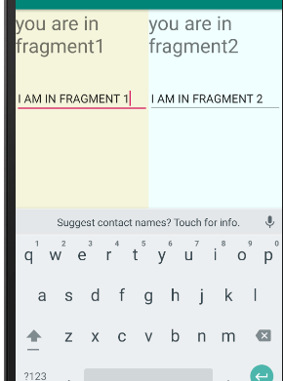
Add Fragment using XML
<LinearLayout android:layout_width="fill_parent" android:layout_height="fill_parent" tools:context=".fragment_example1"> <fragment android:id="@+id/fragment1" android:name="com.example.fragment1" android:layout_width="0px" android:layout_height="match_parent" android:layout_weight="1" /> <fragment android:id="@+id/fragment2" android:name="com.example.fragment2" android:layout_width="0px" android:layout_height="match_parent" android:layout_weight="1" /> </LinearLayout>
Note :
The android:name attribute specifies the Fragment class
to instantiate in the layout.

Slide 81
Activity_fragment1.XML
<TextView android:layout_width="match_parent" android:layout_height="wrap_content" android:text="you are in fragment1" android:textSize="30sp"/> <EditText android:layout_width="match_parent" android:layout_height="wrap_content" android:layout_marginTop="40dp" android:layout_gravity="center_horizontal" />
Activity_fragment2.XML
<TextView android:layout_width="match_parent" android:layout_height="wrap_content" android:text="you are in fragment2" android:textSize="30dp"/> <EditText android:layout_width="match_parent" android:layout_height="wrap_content" android:layout_marginTop="40dp" android:layout_gravity="center_horizontal" />

Slide 82
FRAGMENT1.Class
Inflate the view with the defined fragment layout.
public View onCreateView(LayoutInflater inflater, ViewGroup container, Bundle savedInstanceState) { // inflater : LayoutInflater used to inflate the layout,
//container : parent ViewGroup in which our Fragment layout will be inserted. return inflater.inflate(R.layout.activity_fragment1, container, false);
FRAGMENT2.Class
public View onCreateView(LayoutInflater inflater, ViewGroup container, Bundle savedInstanceState) { // Inflate the layout for this fragment return inflater.inflate(R.layout.activity_fragment2, container, false); }

Slide 83
Fragment Manager
Every activity has its own fragment manager
It maintain references to all fragments inside the activity.
findFragmentByid() method to get a references to a particular fragment inside the activity.

Slide 84
Fragment Transaction
The act of adding and removing fragments to an activity are considered as transaction inside android and managed by an object called FragmentTransaction.
Two methods : add(); and replace();
Case 1: When there is no fragment attached in a container
In this case, both methods will add the fragment to the container.
Case 2: When the fragmentContainer already has fragment/fragments than ,
add(): adds the new fragment on the top another fragment replace(): removes everything then adds the new fragment

Slide 85
Add Fragment using java (MainActivity)
<Button
android:layout_width="wrap_content"
android:layout_height="wrap_content"
android:text=“Add Fragment 1"
android:id="@+id/btn1"
android:textSize="20dp"/>
<Button
android:layout_width="wrap_content"
android:layout_height="wrap_content"
android:text=“Add Fragment 2"
android:id="@+id/btn2"
android:textSize="20dp"/>
<fragment
android:layout_width="200dp"
android:layout_height="match_parent"
android:id="@+id/fragment_id"
/>

Slide 86
Activity_fragment1.XML
<TextView android:layout_width="match_parent" android:layout_height="wrap_content" android:text="you are in fragment1" android:textSize="30sp"/> <EditText android:layout_width="match_parent" android:layout_height="wrap_content" android:layout_marginTop="40dp" android:layout_gravity="center_horizontal" />
Activity_fragment2.XML
<TextView android:layout_width="match_parent" android:layout_height="wrap_content" android:text="you are in fragment2" android:textSize="30dp"/> <EditText android:layout_width="match_parent" android:layout_height="wrap_content" android:layout_marginTop="40dp" android:layout_gravity="center_horizontal" />

Slide 87
FRAGMENT1.Class
Inflate the view with the defined fragment layout.
public View onCreateView(LayoutInflater inflater, ViewGroup container, Bundle savedInstanceState) { // inflater : LayoutInflater used to inflate the layout,
//container : parent ViewGroup in which our Fragment layout will be inserted. return inflater.inflate(R.layout.activity_fragment1, container, false);
FRAGMENT2.Class
public View onCreateView(LayoutInflater inflater, ViewGroup container, Bundle savedInstanceState) { // Inflate the layout for this fragment return inflater.inflate(R.layout.activity_fragment2, container, false); }

Slide 88
MainActivity file
btn1.setOnClickListener(new View.OnClickListener() {
@Override
public void onClick(View view) {
fragment1 fragmentone=new fragment1(); // create instance of fragment1 class
FragmentTransaction transaction=getSupportFragmentManager().beginTransaction();
transaction.replace(R.id.fragment_id , fragmentone);
transaction.commit();
}
});
btn2.setOnClickListener(new View.OnClickListener() {
@Override
public void onClick(View view) {
fragment2 fragmenttwo=new fragment2();
FragmentTransaction transaction=getSupportFragmentManager().beginTransaction();
transaction.replace(R.id.fragment_id , fragmenttwo);
transaction.commit();
}
});

Slide 89
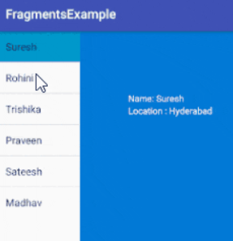
Fragment Example 2 (MainActivity)
<fragment
android:layout_height="match_parent"
android:layout_width="350px"
name="com.fragmentsexample.ListMenuFragment"
android:id="@+id/fragment1"/>
<fragment
android:layout_width="match_parent"
android:layout_height="match_parent"
name="com.fragmentsexample.DetailFragment"
android:id="@+id/fragment2"/>

Slide 90
Fragment_list_item.xml
<LinearLayout
android:orientation="vertical"
android:layout_width="match_parent"
android:layout_height="match_parent">
<ListView
android:layout_width="match_parent"
android:layout_height="wrap_content"
android:id="@android:id/list" />
</LinearLayout>

Slide 91
Fragment_detail_item.xml
<TextView
android:layout_width="wrap_content"
android:layout_height="wrap_content"
android:textColor="#ffffff"
android:layout_marginTop="200px"
android:layout_marginLeft="200px"
android:id="@+id/Name"/>
<TextView
android:layout_width="wrap_content"
android:layout_height="wrap_content"
android:layout_marginLeft="200px"
android:textColor="#ffffff"
android:id="@+id/Location"/>

Slide 92
ListMenuFragment.java
public class ListMenuFragment extends ListFragment { String[] users = new String[] { "Suresh","Rohini","Trishika","Praveen","Sateesh","Madhav" }; String[] location = new String[]{"Hyderabad","Guntur","Hyderabad","Bangalore","Vizag“}; @Override public View onCreateView(LayoutInflater inflater, ViewGroup container, Bundle savedInstanceState) { //onCreateView is called to inflate the layout of the fragment View view =inflater.inflate(R.layout.fragment_list_item, container, false); ArrayAdapter<String> adapter = new ArrayAdapter<String>(getActivity(), android.R.layout.simple_list_item_1, users); setListAdapter(adapter); return view; } @Override public void onListItemClick(ListView l, View v, int position, long id) { DetailsFragment txt = (DetailsFragment)getFragmentManager().findFragmentById(R.id.fragment2); txt.change("Name: "+ users[position],"Location : "+ location[position]); getListView().setSelector(android.R.color.holo_blue_dark); } }
The getActivity() method gives the context of the Activity
The method getActivity() is normally used in fragments to get the context of the activity in which they are inserted or inflated.

Slide 93
DetailFragment.java
public class DetailsFragment extends Fragment { TextView name,location; @Override public View onCreateView(LayoutInflater inflater, ViewGroup container, Bundle savedInstanceState) { View view= inflater.inflate(R.layout.Fragment_detail_item, container, false); name = (TextView)view.findViewById(R.id.Name); location = (TextView)view.findViewById(R.id.Location); return view; } public void change(String uname, String ulocation){ name.setText(uname); location.setText(ulocation); } }

Slide 94
Sensor
Three broad categories of sensors.
Motion Sensors
Environmental sensors
Position sensors
android allows us to get the raw data from these sensors and use it in our application. For this android provides us with some classes.
Eg :
To report a changes in environment a weather application might use temperature sensor and humidity sensor or
A travel application might use the geomagnetic field sensor

Slide 95
Category | Description
Motion Sensors | These sensors are useful to measure acceleration forces and rotational forces along three axes. Motions like swinging, tilting, rotating, shaking is detected using accelerometer. The value of XYZ is used to calculate and detect the motions.
Environmental Sensors | These sensors are useful to measure various environmental parameters, such as air temperature and pressure, illumination, and humidity.
Position Sensors | These sensors are useful to measure the physical position of a device.

Slide 96
Sensor framework
Access all the sensors available on device and to get all the raw sensor data.
by using sensor framework we can perform following things
-It lists all the available sensors on the device
-It determine the capabilities of each sensor, such as its maximum range, manufacturer, power requirements, and resolution.
-It can acquire raw sensor data.
-Register and unregister sensor event listeners that monitor sensor changes.

Slide 97
Android sensor framework provide following classes
Class | Description
Sensor Manager | By using this class we can create an instance of sensor service and this class provides a various methods for accessing and listing sensors, registering and unregistering sensor event listeners ( listener will get informed, if the sensor data changes) and acquiring orientation information.
Sensor | By using this class we can create an instance of a specific sensor and this class provides a various methods that let you determine the sensor's capabilities.
SensorEvent | The system uses this class to create a sensor event object and it provides the raw sensor data, type of sensor that generated the event
SensorEventListener | It provide two callback methods that give information when sensor values (x,y and z) change or sensor accuracy changes.
Public and abstract methods | Description
void onAccuracyChanged(Sensor sensor, int accuracy) | it is called when sensor accuracy is changed.
void onSensorChanged(SensorEvent event) | it is called when sensor values are changed.

Slide 98
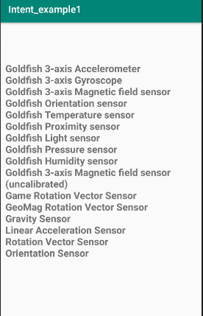
Sensor example
<TextView android:id="@+id/sensorslist" android:layout_width="wrap_content" android:layout_height="wrap_content" android:layout_marginTop="80dp" android:text="Sensors" android:textSize="20dp" android:textStyle="bold" android:layout_gravity="center" android:visibility="gone"/>

Slide 99
public class sensor_example1 extends AppCompatActivity { private SensorManager mgr; private TextView txtList; @Override
protected void onCreate(Bundle savedInstanceState) { super.onCreate(savedInstanceState); setContentView(R.layout.activity_sensor_example1);
//SensorManager : create instance of sensor service class to accessing and listening to sensor mgr = (SensorManager)getSystemService(Context.SENSOR_SERVICE); txtList = (TextView)findViewById(R.id.sensorslist); List<Sensor> sensorList = mgr.getSensorList(Sensor.TYPE_ALL); StringBuilder strBuilder = new StringBuilder(); for(Sensor s: sensorList){ // Sensor : to create instance of specific sensor strBuilder.append(s.getName()+"\n"); } txtList.setVisibility(View.VISIBLE); txtList.setText(strBuilder); } }

Slide 100
Camera
Camera is mainly used to capture picture and video. We can control the camera by using methods of camera api.
Android provides the facility to work on camera by 2 ways:
By Camera Intent : push an intent to default camera application to make it take a photo
Camera Permission - Your application must request permission to use a device camera.
<uses-permission android:name="android.permission.CAMERA" />

Slide 101
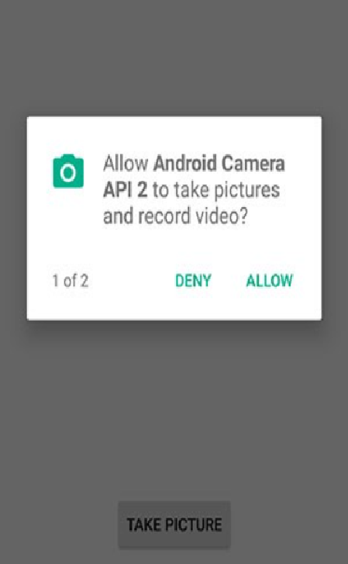
By Camera API : It can be used to control
device camera and used to take
pictures or videos when you are
building a camera application.

Slide 102
1.Using Camera Application By Camera Intent
By using intent action types either MediaStore.ACTION_IMAGE_CAPTURE or MediaStore.ACTION_VIDEO_CAPTURE, we can capture the photos or videos without directly using the Camera object.
In Android MediaStore is a type of DataBase which stores pictures and videos in android.
2 constants of MediaStore class, we can capture picture and video without using the instance of Camera class.
ACTION_IMAGE_CAPTURE
ACTION_VIDEO_CAPTURE
Intent cameraIntent = new Intent(android.provider.MediaStore.ACTION_IMAGE_CAPTURE);

Slide 103
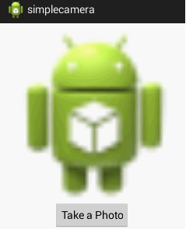
Example of Camera
<Button
android:id="@+id/button1"
android:layout_width="wrap_content"
android:layout_height="wrap_content"
android:layout_alignParentBottom="true"
android:layout_centerHorizontal="true"
android:text="Take a Photo" >
</Button>
<ImageView
android:id="@+id/imageView1"
android:layout_width="fill_parent"
android:layout_height="fill_parent"
android:layout_above="@+id/button1"
android:layout_alignParentTop="true"
android:src="@drawable/ic_launcher" >
</ImageView>

Slide 104
public class MainActivity extends Activity {
private static int CAMERA_REQUEST = 1;
ImageView imageView;
public void onCreate(Bundle savedInstanceState) {
super.onCreate(savedInstanceState);
setContentView(R.layout.activity_main);
imageView = (ImageView) this.findViewById(R.id.imageView1);
Button photoButton = (Button) this.findViewById(R.id.button1);
photoButton.setOnClickListener(new View.OnClickListener() {
@Override
public void onClick(View v) {
Intent cameraIntent = new Intent(android.provider.MediaStore.ACTION_IMAGE_CAPTURE);
startActivityForResult(cameraIntent, CAMERA_REQUEST); // send request to other activity
} }); }

Slide 105
protected void onActivityResult(int requestCode, int resultCode, Intent data) { // call back method called when other activity return result
if (requestCode == CAMERA_REQUEST) {
if (resultCode==RESULT_OK) {
//Android Camera application encodes the photo in the return Intent delivered to onActivityResult() // as a small Bitmap in the extras, under the key "data".
Bitmap photo = (Bitmap) data.getExtras().get("data");
imageView.setImageBitmap(photo);
}
}

Slide 106
Bluetooth
Bluetooth is a way to send or receive data between two different devices.
Android provides Bluetooth API (Provides classes that manage Bluetooth functionality, such as scanning for devices, connecting with devices, and managing data transfer between devices) to perform these different operations.
Scan for other Bluetooth devices
Get a list of paired devices
Connect to other devices

Slide 107
1. android bluetooth Adapter class:
Android provides BluetoothAdapter class to communicate with Bluetooth. Create an object of this class by calling method getDefaultAdapter().
By using BluetoothAdapter object, we can interact with device’s Bluetooth adapter to perform Bluetooth related operations.
syntax:
private BluetoothAdapter BA; BA = BluetoothAdapter.getDefaultAdapter();
2.Android Enable or Disable Bluetooth: enable the Bluetooth of your device, call the intent with the following Bluetooth constant ACTION_REQUEST_ENABLE.
Syntax : Intent turnOn = new Intent(BluetoothAdapter.ACTION_REQUEST_ENABLE);
startActivityForResult(turnOn, 0);
other constants are :
Sr.No | Constant & description
1 | ACTION_REQUEST_DISCOVERABLE This constant is used for turn on discovering of bluetooth
2 | ACTION_STATE_CHANGED This constant will notify that Bluetooth state has been changed
3 | ACTION_FOUND This constant is used for receiving information about each device that is discovered

Slide 108
3. Android List paired Devices :
get a list of paired devices by calling getBondedDevices() method. It returns a set of bluetooth devices.
Syntax :
private Set<BluetoothDevice>pairedDevices;
pairedDevices = BA.getBondedDevices();
Sr.No | Method & description
1 | enable() This method enables the adapter if not enabled
2 | isEnabled() This method returns true if adapter is enabled
3 | disable() This method disables the adapter
4 | getName() This method returns the name of the Bluetooth adapter
5 | setName(String name) This method changes the Bluetooth name
6 | getState() This method returns the current state of the Bluetooth Adapter.
7 | startDiscovery() This method starts the discovery process of the Bluetooth for 120 seconds.

Slide 109
Permissions
<manifest ... >
<uses-permission android:name="android.permission.BLUETOOTH"/>
<uses-permission android:name="android.permission.BLUETOOTH_ADMIN"/>
<uses-permission android:name="android.permission.ACCESS_COARSE_LOCATION"/>
</manifest>
BLUETOOTH_ADMIN to discover the available Bluetooth devices or manipulate Bluetooth settings
BULETOOTH : perform any Bluetooth communication, such as requesting a connection, accepting a connection, and transferring data.
LOCATION : to gather the information about the location of user.
Note: If you use BLUETOOTH_ADMIN permission, then must also have the BLUETOOTH permission.

Slide 110
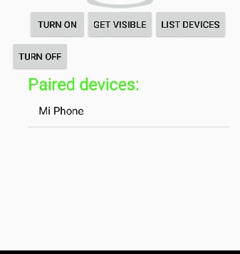
Bluetooth Example
<Button
android:text="Turn On" android:id="@+id/button
android:clickable="true”/>
<Button " android:text="Get visible“
android:onClick="visible" />
<Button
android:text="List devices"
android:onClick="list" android:id="@+id/button3“ />
<Button
android:text="turn off“
android:onClick="off"
android:id="@+id/button4" />
<ListView
android:id="@+id/listView“ />
<TextView
android:text="Paired devices:"
android:id="@+id/textView2“/>

Slide 111
MainActivity
public class MainActivity extends Activity
{ Button b1,b2,b3,b4;
private BluetoothAdapter BA;
private Set<BluetoothDevice>pairedDevices;
ListView lv;
@Override
protected void onCreate(Bundle savedInstanceState)
{ super.onCreate(savedInstanceState);
setContentView(R.layout.activity_main);
b1 = (Button) findViewById(R.id.button); b2=(Button)findViewById(R.id.button2); b3=(Button)findViewById(R.id.button3); b4=(Button)findViewById(R.id.button4);
BA = BluetoothAdapter.getDefaultAdapter(); // Create an object of this class by calling method getDefaultAdapter().
lv = (ListView)findViewById(R.id.listView); }
if(BA==null)
{
// Device won't support Bluetooth
}

Slide 112
// To ON Bluetooth
//enable Bluetooth without leaving our application by using startActivityForResult() method
public void on(View v){
if (!BA.isEnabled()) {
Intent turnOn = new Intent(BluetoothAdapter.ACTION_REQUEST_ENABLE);
startActivityForResult(turnOn, 0);
Toast.makeText(getApplicationContext(), "Turned on",Toast.LENGTH_LONG).show(); }
else {
Toast.makeText(getApplicationContext(), "Already on", Toast.LENGTH_LONG).show(); } }
//To OFF Bluetooth
public void off(View v){
BA.disable();
Toast.makeText(getApplicationContext(), "Turned off" ,Toast.LENGTH_LONG).show(); }

Slide 113
//Make the device discoverable to other devices
public void visible(View v){
Intent getVisible = new Intent(BluetoothAdapter.ACTION_REQUEST_DISCOVERABLE);
startActivityForResult(getVisible, 0); }
// List out Paired devices in List view
public void list(View v){
pairedDevices = BA.getBondedDevices(); // get a list of paired devices
ArrayList list = new ArrayList();
//for each loop to display contents of pairedDevices
for(BluetoothDevice bt : pairedDevices)
list.add(bt.getName());
Toast.makeText(getApplicationContext(), "Showing Paired Devices",Toast.LENGTH_SHORT).show();
ArrayAdapter adapter =
new ArrayAdapter(this,android.R.layout.simple_list_item, list);
lv.setAdapter(adapter);
} }

Slide 114
Main thread / UI thread
All components are instantiate
Dispatching events
Handle call back methods
All UI components are created
Main thread is the thread used to run your application , handle processing data, handling requests, and other main tasks.
The UI thread would be responsible for handling user requests via the UI. It would put a request to the main thread for information or send an instruction.
Do not perform long running operation on main thread
If we perform long running task on main thread it will hang app

Slide 115
Async Task
In Android, AsyncTask allows us to run the instruction in the background and then synchronize again with our main thread.
gives us the liberty to perform heavy tasks in the background and keep the UI thread light thus making the application more responsive.
Exmaple : AsyncTask is just like a side road, while large-slowly moving truck makes traffic problem on the main road, Asynctask keeps those away to make a better path for other traffic.
When to use : if you want to do any resource intensive task which takes more than 5 seconds you should not do it on main thread as it will lead to Application Not Responding (ANR) dialogue pop up.
AsyncTask Class:
Use AsyncTask class to implement an asynchronous long running task.

Slide 116
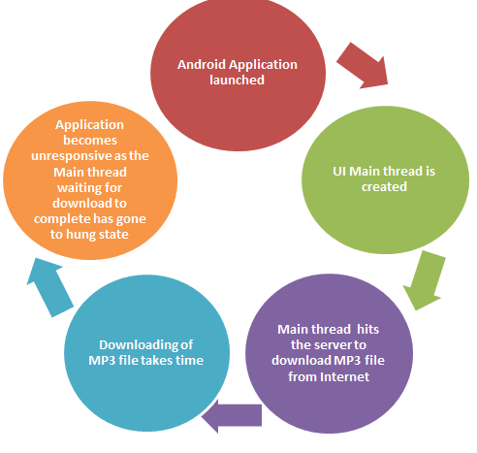
Need of AsyncTask? Assume you have created a simple
Android application which downloads
MP3 file from Internet on launching
the application.
As the response (MP3 file) from server is
awaited, the application has become
unresponsive

Slide 117
AsyncTasks are designed for once-off time-consuming tasks that cannot be run on UI thread. Used for handling those tasks that you cannot make to work on the main thread. presenting the result of that work to the UI thread.
example if you want to load data to a listview from a server after hitting some button
example is fetching/processing data when a button is pressed.
An Async Task is launch when you need it and executed in background. When it's done, the thread is destroyed.
Difference between AysncTask and Service
A Service runs on the main thread of the calling Component’s process while AsyncTasks run the instruction in the background and then synchronize again with our main thread.
For run asynctask activity , your app should be on main thread. After exit from the app there is no asynctask.
But services are not like that, once you start a service it can run after you exit from the app, unless you are stop the service.
Services are not task-oriented. They are not set up to "perform a task" and "deliver a result", like AsyncTasks are
With the help of asynctask we can show progress of given task which is not possible with Service.

Slide 118
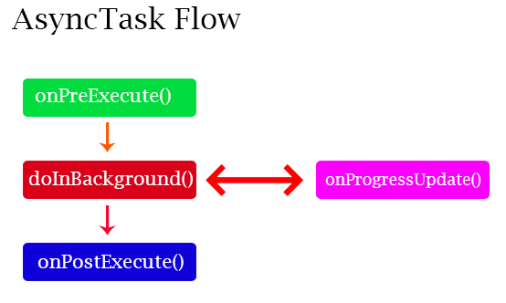
Method of AsyncTask In Android:
onPreExecute() − It invoked on the main UI thread before the task is executed. Before doing background operation we should show something on screen like progressbar or any animation to user.
doInBackground(Params..) − In this method we have to do background operation on background thread. result of the operations must be returned to method i.e onPostExecutes().
It also call publishProgress(progress..) to publish one or more units of progress.

Slide 119
onProgressUpdate(Progress…) − While doing background operation, if you want to update some information on main UI, we can use this method.
This method is used to. display any form of progress in the user interface while the background operations are executing eg : showing progress
onPostExecute(Result) This method is invoked on the main UI thread after the background operation finishes in the doInBackground method.
The result of the background operation is passed to this step as a parameter and then we can easily update our UI to show the results.

Slide 120
AysncTask parameters
Syntax :
AsyncTask<“Params” , “Progress” , “Result”>
Three parameters:
“params” : specifies the type of parameters passed to doInBackground() as an array.
“progress” : specifies the type of parameters passed to publishProgress() on the background thread . These parameters are passed to onProgressUpdate() method.
“Result” : specifies the type of parameters that doInBackground() returns. This parameters are automatically passed to onPostExecute() on the main thread

Slide 121
Need of AsyncTask
By default, our application code runs in our main thread and every statement is therefore execute in a sequence.
If we need to perform long tasks/operations then our main thread is blocked until the corresponding operation has finished.
For providing a good user experience in our application we need to use AsyncTasks class that runs in a separate thread.
This class will executes everything in doInBackground() method inside of other thread which doesn’t have access to the GUI where all the views are present. Hence use of AsyncTask in android application keeps the UI thread responsive at all times.

Slide 122
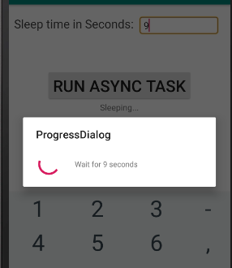
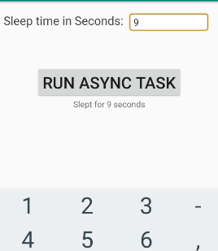
Exp 26 : Async Task Example
Text view
Progress

Slide 123
private Button button; private EditText time; private TextView finalResult;
protected void onCreate(Bundle savedInstanceState) { super.onCreate(savedInstanceState); setContentView(R.layout.activity_async_task_example1); edittext = (EditText) findViewById(R.id.in_time); button = (Button) findViewById(R.id.btn_run); finalResult = (TextView) findViewById(R.id.tv_result); button.setOnClickListener(new View.OnClickListener() { @Override public void onClick(View v) { AsyncTaskRunner runner = new AsyncTaskRunner(); // call PreExecute String sleepTime = edittext.getText().toString(); runner.execute(sleepTime); // call DoInBackground } });

Slide 124
// define subclass AsyncTaskRunner of AsyncTask that override doInBackground() method
private class AsyncTaskRunner extends AsyncTask<String, String, String> { private String resp; ProgressDialog progress1; @Override
//A variable-length argument is specified by three periods(…) which has zero or more arguments // params represents a vararg. protected String doInBackground(String... params) { publishProgress("Sleeping..."); // Calls onProgressUpdate()
try { int time = Integer.parseInt(params[0])*1000; // params[0] is the first string Thread.sleep(time); resp = "Slept for " + params[0] + " seconds"; } catch (Exception e) { e.printStackTrace(); resp = e.getMessage(); } return resp; //return result to PostExecute }

Slide 125
@Override protected void onPostExecute(String result) { // execution of result of Long time consuming operation progressDialog.dismiss(); finalResult.setText(result); } @Override protected void onPreExecute() { progress1 = ProgressDialog.show(async_task_example1.this, "ProgressDialog", "Wait for "+edittext.getText().toString()+ " seconds"); // EditText indicate time } @Override protected void onProgressUpdate(String... text) { finalResult.setText(text[0]); //finalResult is TextView instance }

Slide 126
Multimedia framework of Android

Slide 127
Android multimedia framework is designed to provide a reliable interface for java service. It is a system that includes multimedia applications, frameworks, an OpenCore engine, hardware devices for audio/video/ input, output devices also several core dynamic libraries such as libmedia, libmediaplayservices, and so on.

Slide 128
● Java classes call the Native C library Libmedia through Java JNI(Java Native Interface). Libmedia library communications with Media Server guard process through Android’s Binder IPc (inter process communication) mechanism.
● Media Server process creates the corresponding multimedia service according to the Java multimedia applications. The whole communication between Libmedia and Media Server forms a Client/Server model
Typical video/audio data stream works in Android as follows. Particularly, Java applications first set the URI of the media (from file or network) to PVPlayer through Java framework, JNI and Native C. In this process, there are no data stream flows.
● Then PV Player processes the media data stream with the steps: demux the media data to separate video/audio data stream, decode video/audio data, sync video.audio time, send the decoded data out.

Slide 129
The below is the description of media container , codec/format and network protocol supported by the Android platform.
1. Container: The audio file format is a file for storing digital audio data on a system. This data can be manipulated to reduce the size or change the quality of the audio. It is a kind of container to store audio information.
2. Audio Format: Any format or codec can be used including the ones provided by Android or those which are specific devices. However it is recommended to use the specified file formats as per devices.
3. Network Protocol: Protocols such as RTSP, HTTP,HTTPS are supported in audio and video playback.

Slide 130
Android MediaPlayer CLass
Android is providing MediaPlayer class to access built-in mediaplayer services like playing audio,video e.t.c.
In android ,by using MediaPlayer class we can access audio or video files from application resources(raw).
Syntax :
MediaPlayer mPlayer = MediaPlayer.create(this, R.raw.song);

Slide 131
Methods
getCurrentPosition() : It is used to get the current position of the song in milliseconds.
getDuration() : It is used to get the total time duration of the song in milliseconds.
isPlaying() : It returns true / false to indicate whether song playing or not.
pause(): It is used to pause the song playing.
setAudioStreamType() : it is used to specify the audio streaming type.
setDataSource() : It is used to specify the path of audio / video file to play.
setVolume() : It is used to adjust media player volume either up / down.
seekTo(position) : It is used to move song to particular position in milliseconds.
start() : It is used to start playing the audio/video.
stop() : It is used to stop playing the audio/video.
reset() : It is used to reset the MediaPlayer object.

Slide 132
Example :
play an audio from a URL via HTTP streaming :
String url = ""https://www.soundhelix.com/examples/mp3/SoundHelix-Song-1.mp3""; // your URL here
MediaPlayer mPlayer = new MediaPlayer();
mPlayer.setAudioStreamType(AudioManager.STREAM_MUSIC);
mPlayer.setDataSource(url);
// mPlayer.setDataSource("/sdcard/Music/maine.mp3");//Write your location here
mPlayer.prepare(); // might take long! (for buffering, etc)
mPlayer.start();

Slide 133
text to speech conversion technique
Android allows you convert your text into voice. Not only you can convert it but it also allows you to speak text in variety of different languages.
Text to Speech converts the text written on the screen to speech like you have written “Hello World” on the screen and when you press the button it will speak “Hello World”. Text-to-speech is commonly used as an accessibility feature to help people who have trouble in reading
Instantiate an object of TextToSpeech class and also specify the initListener. Its syntax is given below:
private EditText ;
ttobj=new TextToSpeech(getApplicationContext(), new TextToSpeech.OnInitListener() {
@Override
public void onInit(int status) {
}
});
OnInitListener to notify the completion of initialization. During the initialization, we can set the audio pitch rate, audio speed, type of language to speak, etc. based on our requirements.
Eg : ttobj.setLanguage(Locale.UK);
void onInit (int status) : Called to signal the completion of the TextToSpeech engine initialization. The status can be SUCCESS or ERROR
call speak method of the class to speak the text.
Eg : ttobj.speak(toSpeak , TextToSpeech.QUEUE_FLUSH , null);

Slide 134
Methods of TextToSpeech class
Method | Description
int speak (String text, int queueMode, HashMap params) | converts the text into speech. Queue Mode may be QUEUE_ADD or QUEUE_FLUSH. Request parameters can be null, KEY_PARAM_STREAM, KEY_PARAM_VALUME etc.
int setSpeechRate(float speed) | it sets the speed for the speech.
int setPitch(float speed) | it sets the pitch for the speech.
int setLanguage (Locale loc) | it sets the locale specific language for the speech.
void shutdown() | it releases the resource set by TextToSpeech Engine.

Slide 135
TextToSpeech.QUEUE_FLUSH
Each TextToSpeech instance can manage its own queue in order to control which utterance will interrupt the current one and which one is simply queued. Here the first speak () request would interrupt whatever was currently being synthesized: the queue is flushed and the new utterance is queued.
Android TextToSpeech QUEUE_FLUSH Queue mode where all entries in the playback queue (media to be played and text to be synthesized) are dropped and replaced by the new entry.
QUEUE_ADD : Queue mode where the new entry is added at the end of the playback queue.

Slide 136
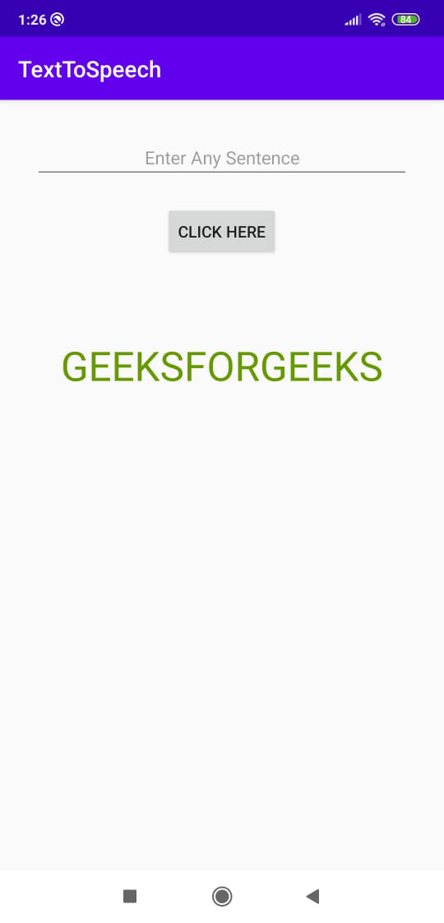
Text to Speech Example

Slide 137
public class MainActivity extends AppCompatActivity {
EditText Text;
Button btnText;
TextToSpeech textToSpeech;
@Override
protected void onCreate(Bundle savedInstanceState) {
super.onCreate(savedInstanceState);
setContentView(R.layout.activity_main);
Text = findViewById(R.id.Text);
btnText = findViewById(R.id.btnText);
textToSpeech = new TextToSpeech(getApplicationContext(), new TextToSpeech.OnInitListener() {
@Override
public void onInit(int status) {
if(status!=TextToSpeech.ERROR){
// To Choose language of speech
textToSpeech.setLanguage(Locale.UK);
}
});
btnText.setOnClickListener(new View.OnClickListener() {
@Override
public void onClick(View view) {
textToSpeech.speak(Text.getText().toString(),TextToSpeech.QUEUE_FLUSH,null);
} });
} }

Slide 138
SQLite
SQLite is an open-source relational database i.e. used to perform database operations on android devices such as storing, manipulating or retrieving persistent data from the database. It is embedded in android by default. So, there is no need to perform any database setup or administration task.
Support standard relational db features.
To create and upgrade a db in your android app , create subclass of SQLiteOpenHelper class .

Slide 139
SQLiteOpenHelper
contains a useful set of APIs for managing your database
In android, by using SQLiteOpenHelper class we can easily create required database and tables for our application. To use SQLiteOpenHelper, we need to create a subclass that overrides the onCreate() and onUpgrade() call-back methods. The SQLiteOpenHelper only require the DATABASE_NAME to create database.
After extending SQLiteOpenHelper you will need to implement its methods onCreate, onUpgrade and constructor.
SQLiteOpenHelper will ease the management of your SQLite database tremendously, by opening databases when needed, creating databases if they do not exist as well as upgrading as necessary.

Slide 140
Database - Helper class
For managing all the operations related to the database , an helper class has been given and is called SQLiteOpenHelper. It automatically manages the creation and update of the database. Its syntax is given below
public class DBHelper extends SQLiteOpenHelper {
public final static String DATABASE_NAME = "Student.db";
public final static String TABLE_NAME = "student_info";
public final static String COL_1 = "ID";
public final static String COL_2 = "Roll_No";
public final static String COL_3 = "Name";
public DBHelper(Context context){
super(context,DATABASE_NAME,null,1);
}
public void onCreate(SQLiteDatabase db) {
db.execSQL("CREATE TABLE "+TABLE_NAME+" (ID INTEGER PRIMARY KEY AUTOINCREMENT, ROLL_NO TEXT, NAME TEXT)");
}
public void onUpgrade(SQLiteDatabase database, int oldVersion, int newVersion) {db.execSQL("DROP TABLE IF EXISTS "+TABLE_NAME);
onCreate(db);
}

Slide 141
Database - Creation
openOrCreateDatabase() method to create a database.
eg:
SQLiteDatabase db = openOrCreateDatabase("your database name", MODE_PRIVATE,null);
Parameter:
String -> It is the database name, If the given name already exist in your package it will open the database, if not it will create a database with the given name.
Int -> The mode for opening the database usually it is MODE_PRIVATE.
CursorFactory -> It is nullable or optional.

Slide 142
Describe with example, how to create a simple database in SQLite (Assume suitable data). (4M : Description 1 M, 1 M for XML file , 2 M for Java File)
1. The package imported into the application is android.database.sqlite.SQLiteDatabase.
2. Here the class used is SQLiteDatabase.
3. The method used to create the database or connect to the database is openOrCreateDatabse() method.
XML
<RelativeLayout>
<Button android:text="Create SQLite Database" android:layout_width="fill_parent“
android:layout_height="wrap_content“
android:layout_centerHorizontal="true“
android:layout_marginTop="46dp“
android:id="@+id/button" />
</RelativeLayout>

Slide 143
Java code
public class MainActivity extends AppCompatActivity {
SQLiteDatabase db;
Button createData;
@Override
protected void onCreate(Bundle savedInstanceState) { super.onCreate(savedInstanceState); setContentView(R.layout.activity_main);
createData = (Button)findViewById(R.id.button);
createData.setOnClickListener(new View.OnClickListener() {
@Override
public void onClick(View view) {
db = openOrCreateDatabase(“student", Context.MODE_PRIVATE, null);
} }); }

Slide 144
Table Creation
we can create table or insert data into table using execSQL method defined in SQLiteDatabase class.
eg:
db.execSQL("CREATE TABLE "+stud_info +" (ID INTEGER PRIMARY KEY AUTOINCREMENT, ROLL_NO TEXT, NAME TEXT)");
Insertion
public boolean insertData(String id,String roll_no, String name){
SQLiteDatabase db = this.getWritableDatabase(); ContentValues contentValues = new ContentValues(); contentValues.put(COL_2, roll_no); contentValues.put(COL_3, name); long result= db.insert(stud_info,null, contentValues);
if(result == -1){
return false;
}
else{
return true;
}

Slide 145
Database - Fetching
retrieve anything from database using an object of the Cursor class.
rawQuery :it will return a resultset with the cursor pointing to the table. We can move the cursor forward and retrieve the data.
Eg:
//1st parameter is query , 2nd is use to pass value in where clause
Cursor resultSet = db.rawQuery("Select * from employee", null); resultSet.moveToFirst();
String username = resultSet.getString(0);
String password = resultSet.getString(1);

Slide 146
public Integer deleteData(String id){
SQLiteDatabase db = this.getReadableDatabase();
return db.delete(TABLE_NAME,"id=?",new String[]{id});
}
public boolean updateData(String id,String roll_no, String name){
SQLiteDatabase db = this.getReadableDatabase();
ContentValues cv= new ContentValues(); //creating instance of contentvalues class
cv.put(COL_1,id);
cv.put(COL_2, roll_no); //insert value in a column
cv.put(COL_3, name);
Integer rows=db.update(TABLE_NAME,cv,"id=?",new String[]{id});
if(rows>0)
return true;
else
return false;
}

Slide 147
Steps to access sqlite database
1) Run the Code
2) Go to Views
3) In Views Select Tool Windows
4) In Tool Windows Select Device File Explorer
5) In Device File Explorer go to data
6) In data again go to data
7) Now In data Select the name package of the Project
8) If the database has been created than in that folder a databases folder will appear
9) In the databases folder you will see the database that has been created
10) Right Click on .db file and Select Save As
11) Save the .db file
12) Now go to https://sqliteonline.com/ and Select on File
13) In File Select Open DB and Choose the .db file that you have saved
14) Now you can View the Database and its data

Slide 148
Name two classes used to play audio and video in Android. 2M
1) MediaPlayer
2) MediaController
3) AudioManager
Describe multimedia framework of Android with diagram. 4M
Explain text to speech conversion technique in android 4M
Develop an application to convert “thanks” text to speech as given : 6M

